Slide 1

Fusion Methods in Biometrics

Slide 2
Problems with Unimodal Systems
Unimodal Systems may not be able to effectively identify a person.
As we have mentioned, noise is one of the main reasons for a reduction in performance of any soft-computing technique. Noise often affects the biometrics to such a great extent that it becomes very difficult to train and test the systems at high accuracies.
In many systems, the features are not good enough and change for the same person by large amounts. The possibility of a large number of classes or people also induces problems when using these systems in real-life applications.
Another major problem is when systems occurs when the inputs are such that the intraclass distance is not very high. In such cases, the various classes or people lie very close to each other in the input space

Slide 3
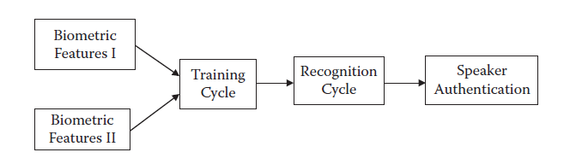
Motivation for Fusion Methods
Additional help is required for the system to start behaving normally again.
In classification problems, this help or assistance is usually done by adding attributes. These added attributes store a great deal of information and may be used for all of the identification purposes.
In the context of what we are studying, this might mean adding a few attributes that are then recorded. This may involve recording larger distances in face recognition or larger coefficients in wavelet analysis.
The general problem-solving methodology in fused biometric systems.

Slide 4
The Workings of Fusion Methods
The addition of attributes increases the ability of these systems to separate the regions of the various classes and thus to learn easily and perform well. The developed system can now use the best features of the individual systems and thus perform to its maximum.
The increase in attributes increases the dimensions, and every dimension carries some classifying power.
Such a system, however, has disadvantage. The addition of attributes increases the system size, so that the system must now adjust more parameters. In the case of ANNs, these parameters are the modifiable weights and biases.
In the case of fuzzy systems, these parameters may be the possibility of rules. The increase in the number of parameters requires a greater data set in order to adjust all the values in such a way that the system reaches its minima in terms of the performance error.

Slide 5
What Can Be Fused?
Fused systems are very naturally observed in the natural world. For example, it is often difficult to recall a person by voice alone. However, the person may be easily recalled by seeing the person talk.
The important decision to be made is which biometric identities or modalities can be mixed together. In practice, there is no restriction. We can fuse any two sets of modalities to make an effective identification system, and the resulting system would be able to reap the benefits of the fused biometric systems.
In fused biometric systems, we try to fuse together the systems that are most related so that there is no discomfort to the user. The recording procedure should also not be difficult. For these reasons, we fuse related features, such as speech and face.

Slide 6
Unimodal or Bimodal?
Fused systems perform much better than classical, single-modality systems.
Capturing the multiple modalities and making a system from them may not always be easy. Questions of integration, input devices, device placement, and so forth must be addressed.
In addition, even though these systems resist noise, they may not behave very well in all circumstances. If one of the modalities gives very bad results due to noise or similar limitations, the system’s performance may decrease instead of increasing.

Slide 7
A Note for Functional Prediction Problems
For a classification problem, fusing or combining the attributes results in greater flexibility. However, for any functional prediction problem, it is assumed that all the major parameters that affect the output are known and present as an input to the system. This is a major point of difference between functional prediction and classification problems.
In functional prediction problems, the inputs absent from the system are either so irrelevant that they do not largely affect the system or assumed to be constant among all the training and testing data.
Many commercial biometric systems use fingerprint, face, or voice. Each modality has both advantages and disadvantages (e.g. discriminative power, complexity, robustness). User acceptability is an important criterion for commercial applications.

Slide 8
Fusion of Face and Speech
The first system that we present here is the fusion of face with speech. We studied the two individual systems under physiological and behavioral biometrics, respectively.
These fused systems, which consist of a camera and microphone, may easily be used to capture and attain the data at the user’s convenience. The camera records an image of the face, while the microphone records the speech.

Slide 9
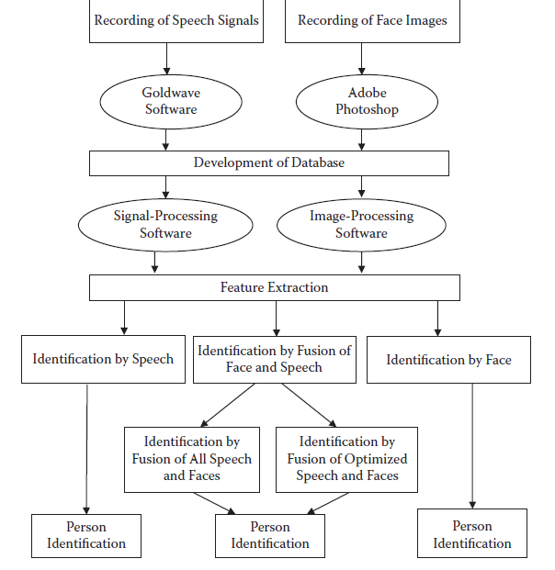
Fusion of Face and Speech

Slide 10
Fusion of Face and Speech
Working
The basic methodology remains the same as for the individual systems. Data acquisition, preprocessing, and feature extraction are exactly the same as in the individual systems. The only difference is that they have been put together to make a combined system.
The features we use from speech are maximum amplitude, cepstrum max, formant frequency (F1 to F4), peak and average power spectral density (PSD), time duration , number of zero crossing, pitch, and pitch amplitude.
The features that we use from the face are length of eye 1, width of eye 1, center dimension of eye 1, center dimension of eye 2, length of eye 2, width of eye 2, length of mouth, width of mouth, center dimension of mouth, distance between center points of eye 1 and eye 2, and distance between center points of eyes and mouth.

Slide 11
Fusion of Face and Speech
The set of features that we select from face and speech are formant frequency (F1 to F4), peak and average PSD, length and width of the mouth, distance between the center points of eye 1 and eye 2, and the distance between the center points of the eyes and mouth.
Results
Data for both speech and face features were collected from 20 people. All the features for both the face and speech were extracted independently and made up the database used for experimental purposes.
We first solved the problem with Case 1, in which all the features were given as an input to the system, and the system was then asked to identify the person. The ANN architecture used for experimental purposes consisted of 2 hidden layers with 15 and 75 neurons each. The error goal was kept at 0.01; the learning rate, at 0.1; and momentum, at 0.5. The system’s training curve is given in Figure

Slide 12
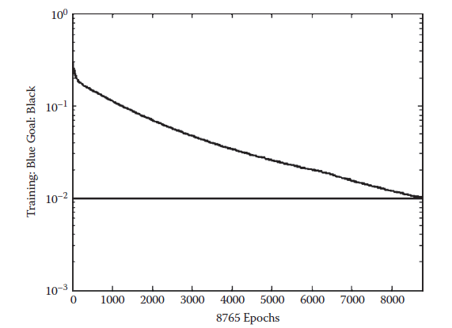
Fusion of Face and Speech
The training curve for Case 1 of the fusion of speech and face.

Slide 13
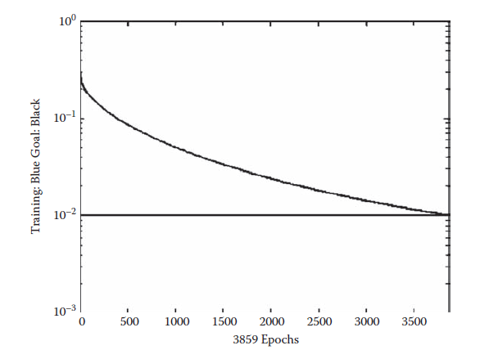
Fusion of Face and Speech
The second experiment was for Case 2, in which we tried to restrict the number of features given to the system. The ANN architecture used for experimental purposes consisted of 2 hidden layers with 15 and 75 neurons each. The error goal was kept at 0.01; the learning rate, as 0.1; and momentum, at 0.5. The system’s training curve is given in Figure :

Slide 14
Fusion of Face and Ear
In this section, we again fuse two biometric modalities that correlate very well to each other: the face and the ear. Both of these inputs are taken with the help of cameras. The only difference is that the face is shot from the front, while the ear photo is taken from the side.
In the face and ear identification that we do here, we use the Haar wavelet transform for the purpose of feature extraction. This transform also extracts the major features from the entire image and best represents the image with the least amount of information loss.

Slide 15


Haar Transform
The Haar wavelet is the first-known wavelet. The Haar transform is used to transform any point of the form [x(1), x(2)]T into another space having the corresponding points [y(1), y(2)]T. This is done with the help of a transformational matrix T. The relation between x and y is given by Equation :
where the matrix T is given by Equation :

Slide 16
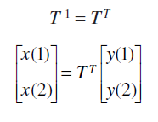
Haar Transform
This means that y(1) and y(2) are the addition and subtraction of x(1) and x(2), respectively, and are scaled by a factor of root of 2 to keep the energy constant.
T represents an orthogonal matrix whose rows have been normalized to have a magnitude of 1. In such a case :

Slide 17
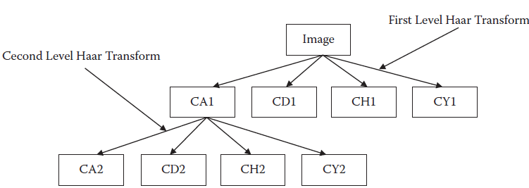
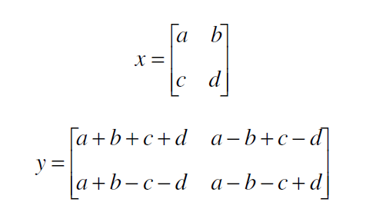
Haar Transform
Graphical representation of wavelet decomposition.

Slide 18
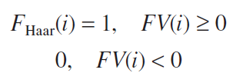
Feature Extraction
Face
The face may be visibly different each time it is captured by the camera for various reasons, including changes in position, pose, and so forth.
In addition, when taking a facial sample from the subject, the face must be extracted from the image, as it may include background or the person’s neck.
The face is selected manually by taking three points (left eyeball, right eyeball, and center of lower lip) using mouse viz.
Four-level wavelet transformation is applied to decompose the face and obtain the features.
At this level, coefficient matrices are combined into a single feature matrix, or feature template FV = [CD4 CV4 CH4]. This is used to calculate the binarized code FHaar, given by Equation :

Slide 19
Feature Extraction
Ear Feature Extraction
Ears have several advantages over complete faces, including reduced spatial resolution, a more uniform distribution of color, and less variability in terms of expressions and orientation of the face.
All the images are taken from the right side of the face from a distance of approximately 15 to 20 centimeters. The images are carefully taken so that the outer ear shape is preserved.
The ear part of the image is manually cropped from the side face image and is then converted to a grayscale image.

Slide 20
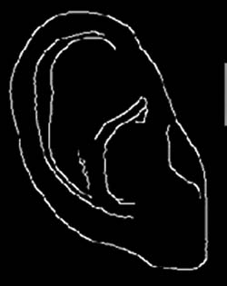
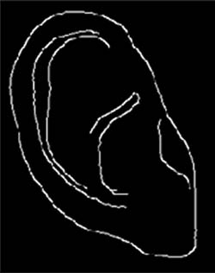
Feature Extraction
Ear image before noise removal.
Ear image after noise removal.

Slide 21
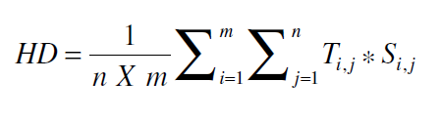
Classification
Classification is done using the Hamming distance approach. This step is different from the previously discussed approaches that we seen throughout the text. The Hamming distance approach tries to find the deviation between the unknown input and the template of that same input that is already in the database.
The formula for the Hamming distance (HM) is given by Equation :
where Ti,j* Si,j is the XOR operator.

Slide 22
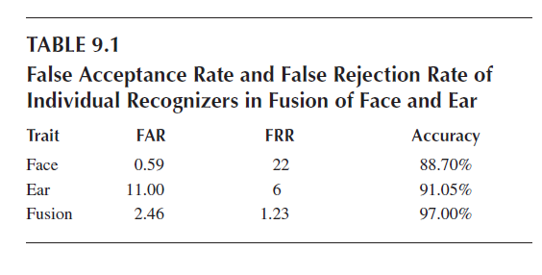
Results
The system was tested using a database built for 30 users. The training database contains a face and an ear image for each individual. The face and ear images were captured under a controlled environment using a digital camera.
In the first experiment, the individual systems for only the face and only the ear were developed and tested for FAR, FRR, and accuracy.

Slide 23
Concluding Remarks for the Fusion of Face and Ear
In this section, we fused two very commonly used and similar biometric systems—the face and the ear.
We saw that the fused system performed much better than the individual systems in terms of performance, training time, and training goal.
The performance table and accuracy curve show that the multimodal system performs better as compared with the unimodal biometrics, with an accuracy of more than 97 percent.

Slide 24
Recognition with Modular ANN
This technique is inspired by the modular neural network (MNN) architecture.
We also solve the problem of fusing face and speech systems. The same features are used for this problem as were used in the preceding sections.
Problem of High Dimensionality
We have seen that face and, to a large extent, speech both have a very high dimensionality. This high dimensionality introduces various restrictions into the systems. These restrictions include the need for a very large training data set for optimal training and the resulting long training time.
We must restrict the number of epochs and even the training output.

Slide 25
Recognition with Modular ANN
In fused systems, we mix two problems that are already of high dimensionality. This naturally results in a system with an even larger dimensionality.
In an attempt to increase the recognition rate,we might choose to increase the dimensions; but this might actually lower the recognition rate due to the excessive dimensionality problems.

Slide 26
Modular Neural Networks
The modular neural networks (MNNs) offer a good means for problem solving, in that they use the modularity of ANNs to divide the entire task into modules.
Each module is solved by a separate unit of the system. Later the results of the various units are combined to yield the final system.
Here we follow the same principle of modularity. We try to break the entire task into a set of smaller tasks and then use those smaller tasks for the purpose of recognition.
This procedure involves the creation of an integrator that divides the tasks and assembles the results. The basic aim is to reduce the dimensionality without losing information.

Slide 27
Modular Neural Networks
Each module consists of a number of attributes of the system. The system is given only these attributes and no others; this restricts the dimensionality of every module. We then independently train the various modules by the selected attributes from the training data set. At the time of testing, each module is given its part of the attribute and calculates its own result.
Then we build an integrator that is responsible for integrating the individual outputs to yield the correct system output. The solution is built over a classification problem, in which the input must be mapped onto some class. Each ANN or module outputs the probabilities of the occurrence of the various classes as the final output. This probability lies between –1 to 1, where –1 means that the ANN is sure it is not the output and 1 denotes that the ANN is sure it is the output.

Slide 28
Modules
In all, we have 11 attributes corresponding to speech: time duration, number of zero crossing, max cepstrum, average PSD, pitch amplitude, pitch frequency, peak PSD, and four formants (F1 to F4). We have 13 attributes for the face: length of eye 1, width of eye 1, center dimension x 1, center dimension y 1, length of eye 2, width of eye 2, center dimension x 2, center dimension y 2, length of the mouth, width of the mouth, center dimension x, center dimension y, distance from eye to eye, and distance from eye to mouth.
The first module covers some of the prominent speech attributes: time duration, max cepstrum, pitch amplitude, peak PSD, and F2 and F4.
The second module contains the rest of the speech features: zero crossing, average PSD, pitch frequency, and F1 and F3.

Slide 29
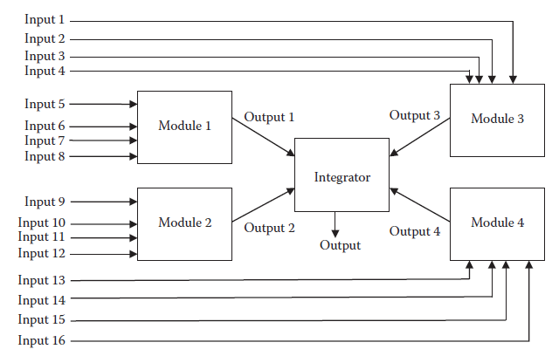
Artificial Neural Networks
Each module here is an ANN. Each is trained using the BPA. We adopt a classification style of representation for the ANN, in which there are as many outputs as there are number of classes, or people.
The division of inputs among modules.

Slide 30
Integrator
We integrate the various solutions by the various ANNs in order to generate a final solution returned by the system.
Each ANN i gives c outputs <vi1, vi2, vi3, … , vic >, where each vik is the probability of the occurrence of the class k measured on a scale of –1 to 1. The integrator simply averages the different probabilities classwise from the different ANNs.
Results
The experiments were done on a database of 20 people. The features mentioned earlier were used and divided using the same strategy. All the inputs were normalized to lie in an interval between 0 and 1. Each ANN had one hidden layer.

Slide 31
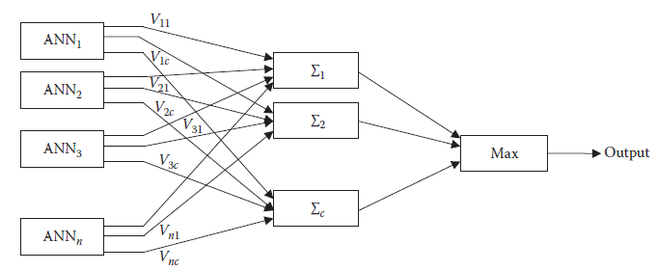
Results
The integrator in the modular neural network approach.

Slide 32
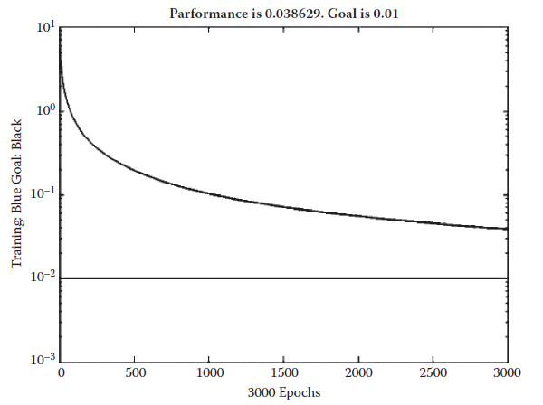
Results
Training curve 1 of the artificial neural network for the fusion of face and speech.

